Slide 1
Desktop Robotic Arm Pick & Place
Team 10

Slide 2
Table of contents
01
04
02
05
03
06
Introduction
MATLAB Simulations
Process Overview
Coppelia & Python
DH & Calculations
Hardware Implemnt

Slide 3
01
Introduction
Design, simulate, and implement a robotic arm for pick-and-place operations.

Slide 4


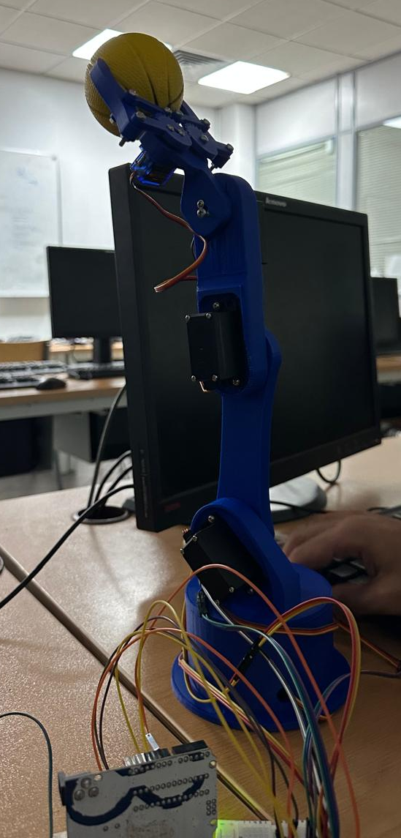

Introduction

Slide 5
02
Process Overview

Slide 6
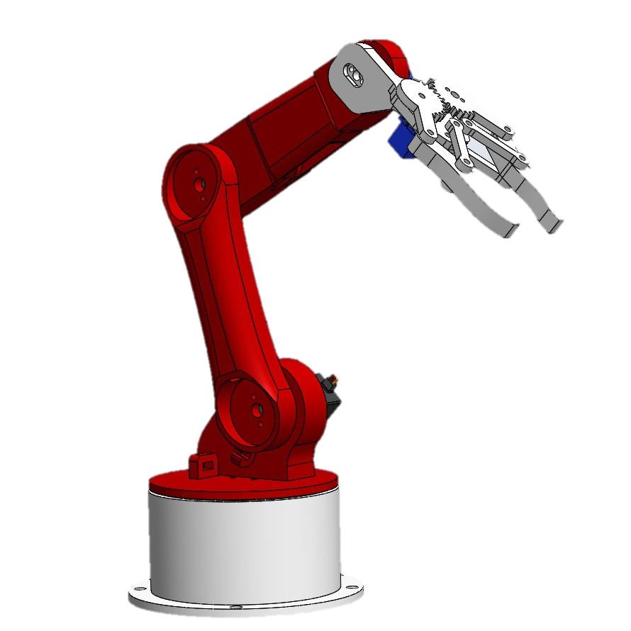
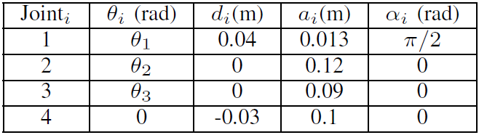
Process Overview
SolidWorks Modeling
Hand calculations (DH conventions)
I used SolidWorks to design and refine the 3D model of the robotic arm, ensuring it was optimized for 3D printing and functional integration.
I started with hand calculations using DH Table to define the robotic arm's geometry to and establish the basis for forward and inverse kinematics.

Slide 7
Process Overview
MATLAB simulation (FK, IK, trajectory planning)
Python + CoppeliaSim (validation and simulation)
In MATLAB, I implemented forward and inverse kinematics to calculate the end-effector's position from joint angles and determine the joint angles for a desired position. Additionally, I performed forward and inverse velocity kinematics to analyze the arm's motion at different speeds and planned joint-space trajectories for smooth transitions between positions, validating each step through simulations.
"In Python and CoppeliaSim, I validated the kinematic calculations and trajectory planning by simulating the robotic arm's motion. This allowed me to test the accuracy of forward and inverse kinematics, as well as the performance of the planned trajectories, in a dynamic 3D environment."

Slide 8
03
DH & Calculations
Mohammed Hassan El-Attar

Slide 9
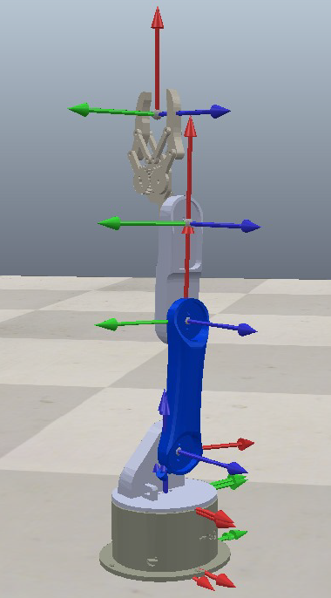
DH & Calculations
"I used DH conventions to parameterize the robotic arm's geometry, defining joint relationships and deriving the transformation matrices needed for forward and inverse kinematics."

Slide 10
04
MATLAB Simulations
Waleed Atef Hassan

Slide 11
MATLAB Simulations
FWD Position
Inverse Position
Velocity
"I calculated forward kinematics by inputting the joint angles to obtain the transformation matrix, which provided the end-effector's position in terms of x, y, and z. This helped visualize the robotic arm's movement and validate the kinematic model using plots and simulations."
I used inverse kinematics to determine the required joint angles for a given end-effector position. By inputting the target position, I solved for the corresponding joint angles, ensuring the arm could reach the desired location accurately in the simulation.
I also tested forward and inverse velocity kinematics to analyze the arm's motion at different speeds, ensuring smooth control of the end-effector's velocity and corresponding joint velocities.

Slide 12
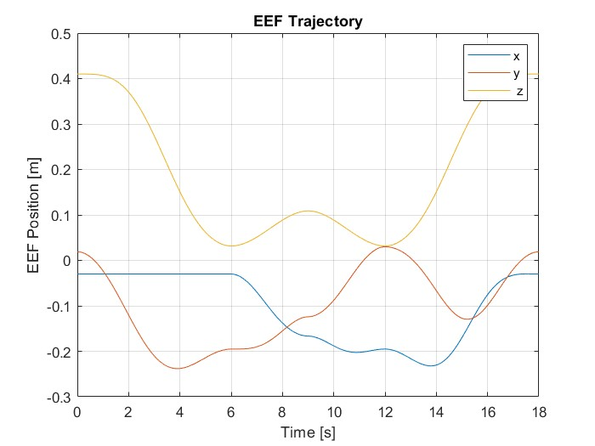
MATLAB Simulations
We used joint-space trajectory planning, where we defined the initial and final positions of the end-effector, made initial guesses for the joint angles, and generated smooth joint angle arrays for motion. The plot here shows the robot's motion in the x, y, and z axes, illustrating the planned trajectory.

Slide 13
05
Coppelia & Python
Abullah Mohamed

Slide 14
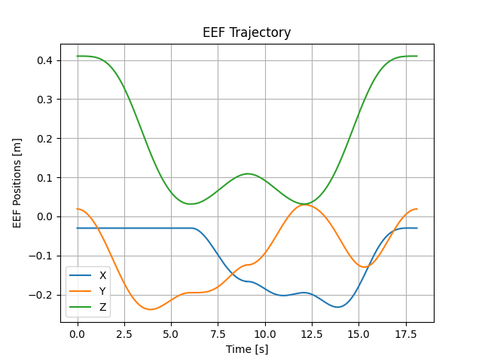
Coppelia & Python
"Everything coded in MATLAB, including kinematics and trajectory planning, was rewritten in Python and tested on the CoppeliaSim model. This allowed further verification of the robotic arm's motion, velocities, and trajectory accuracy in a dynamic simulation environment."

Slide 15
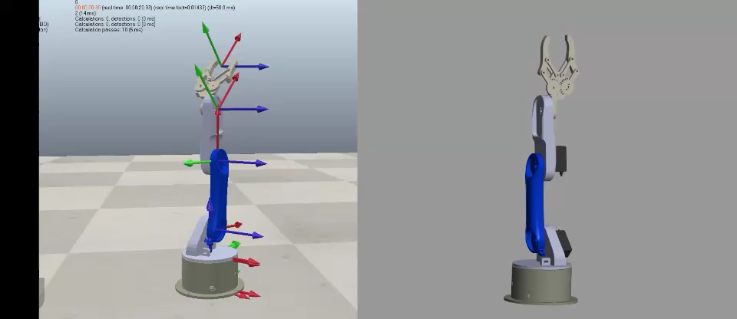
Coppelia & Simscape
Omar Magdy

Slide 16
06
Hardware
Fouad El-Sheikh

Slide 17
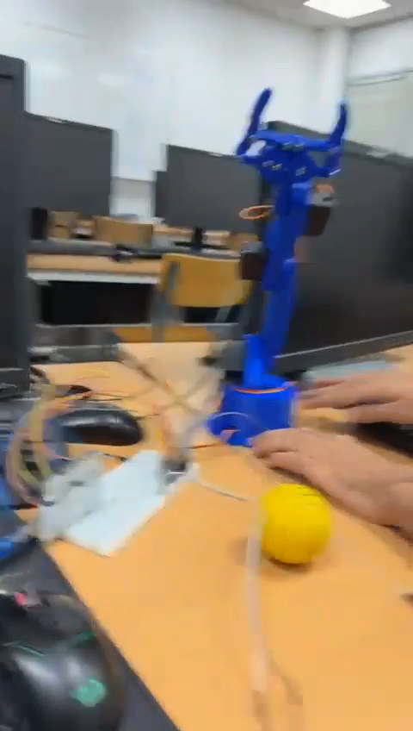
Hardware

Slide 18
Thanks

